Slide 1
UDISE+ EDUCATION REPORT
AARTHI KRISHNAN
aarthiai163@gmail.com

Slide 2
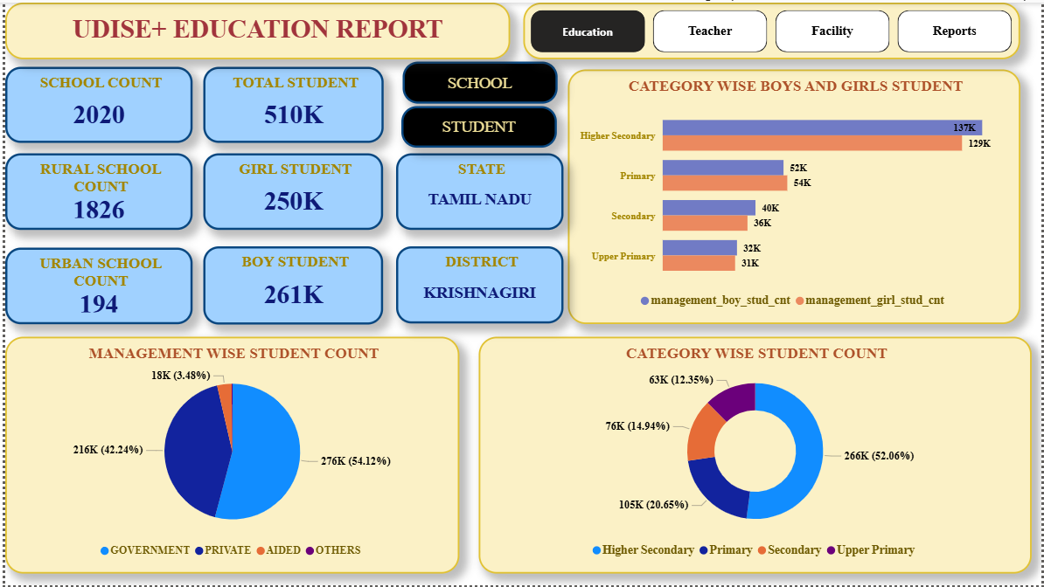
EDUCATION PAGE

Slide 3
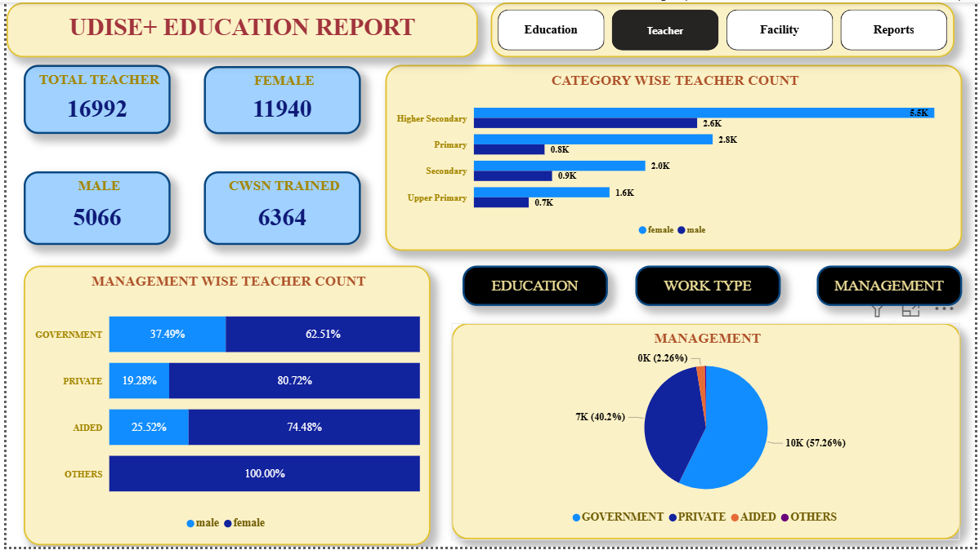
TEACHER DETAIL PAGE

Slide 4
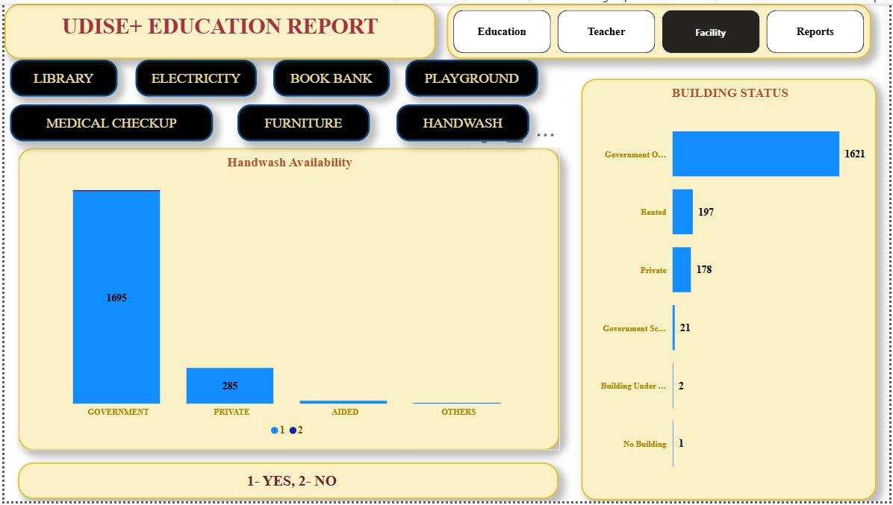
FACILITY DETAIL PAGE

Slide 5
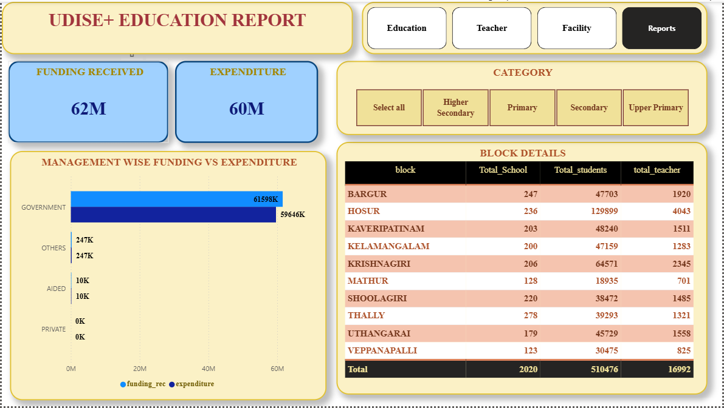
FINAL REPORT PAGE

